Slide 1
SYNOPSIS PRESENTATION TOPIC:EMPLOYEE MANAGEMENT SYSTEM
ROLL NO: 2200290140087
MANSI PANWAR
UNDER THE SUPERVISION OF
Dr. AMIT KUMAR(Assistant professor)

Slide 2
TABLE OF CONTENT
Page Number
Abstract 3
Introduction 4
Project Objective 5-7
Literature Review 8-9
Data Flow Diagram 10
References 11

Slide 3
ABSTRACT
Companies and organizations, large and small, usually have a huge army of people working under them. In such a scenario with a large number of personnel to manage, it becomes difficult to efficiently monitor and manage the activities of human resources. Such companies and organizations need sophisticated employee management systems that can handle everything related to their human resources . The purpose of this project is to set up an advanced employee management system that integrates all relevant information from the enterprise's human resources department. It has the main components of managers and employees. The manager is responsible for company information , vacation management, and payroll, and also adds adjustments to employee details. Similarly, employees can use this system to check vacation status, view salary details and annual leave lists, and file or cancel complaints.

Slide 4
INTRODUCTION
An employee is a very important part of any organizations. Without the employees, there would not be any proper functioning of the organization. Employees are the backbone of any company. The employee management system is an application that will track the records of all the employees of the organization. This application will contain the details like name, designation, salary information, attendance details, leave details, client details, project details etc. The performance of the employees can also be kept track of through this application. This application can contain the administrator who can post the announcements, holidays, birthdays and notes. This will be one of the interesting projects that one can work on and implement in a real-time world.

Slide 5
SYSTEM REQUIREMENTS
1. Hardware Requirement
Laptop or PC
Windows 7 or higher
I3 processor system or Higher
8 GB RAM or Higher
100 GB ROM or Higher
2. Software Requirement
Laptop or PC
Java (AWT, Swing)
MySQL
IDE-NetBeans

Slide 6
PROJECT OBJECTIVE
Increased efficiency: The benefits of Employee management systems automate many HR processes, which can save time and reduce errors. For example, employee data can be stored in a centralized database, making it easy to access and update. This can eliminate the need for manual data entry and reduce the risk of errors.
Improved communication: The benefits of Employee management systems can facilitate communication between HR departments and employees. For example, employees can use the system to access information about their benefits, request time off, or communicate with HR representatives. This can improve transparency and reduce misunderstandings.

Slide 7
Better compliance: One of the best advantages of Employee management systems can help organizations comply with legal requirements related to HR. For example, the system can automatically calculate payroll taxes and ensure that employees are classified correctly. This can reduce the risk of legal penalties and fines.
Enhanced employee engagement: Employee management systems can provide employees with tools to track their performance and career development. For example, the system can provide employees with performance feedback, training opportunities, and career advancement resources. This can increase employee engagement and reduce turnover.

Slide 8
Improve the Work Environment: A good staff management system can help you improve the work environment. Employees who are happy are more likely to perform well and be productive. This means that your employees will have a better chance of staying with your company, which is important if you want to grow.

Slide 9
LITERATURE REVIEW
Existing System
The existing employee management system in the organization still uses the ordinary classical methods which are merely based on pen-paper to record the data of their employees. Large quantities of registers are to be maintained for this purpose which results in downright waste of time in generating reports or searching for employee’s records and loss of data if any file is lost. It is also an arduous task for organizations as it is an expensive process. However, somewhere new technologies such as web based systems, Iot based systems are used but they also are costly and difficult to implement at some places. The other techniques that are in the market are dependent on facial recognition, biometric scan or card punching. But all of these require an external device to be installed in the working area, which is again a costly process and requires regular maintenance

Slide 10
Proposed System
The proposed system is based on an application that runs on smartphones, and requires internet connectivity. This system provides facilities listed below:
1. employer has to add employee and required details,
2. employer can set public holiday of an organisation a day before
3. employer can not edit the holidays that have passed
4. employer have to click get salary to get salary of every employee, he will get a salary of previous month
5. employer can edit and delete the employee
6. the employee has to install the app and follow the described procedure to set up the app, and then he has to scan the QR code for In at a time of entering the premises. And, has to scan another QR for Out at a time of leaving the premises,

Slide 11
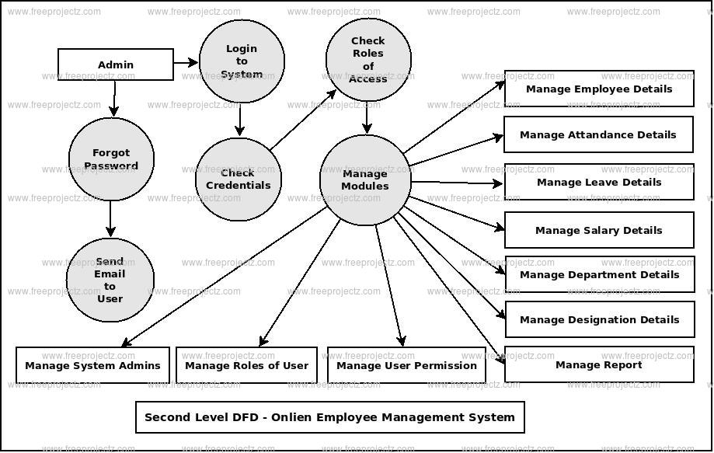
DATA FLOW DIAGRAM

Slide 12
REFERENCES
https://github.com/topics/inventory-management-system
https://lnu.diva-portal.org/smash/get/diva2:204828/FULLTEXT01.pdf

